Slide 1
CS174 Object Oriented Programming
Professor Ann Marie Schilling

Slide 2
About the Class
This class will further your experience with the Java programming language and introduce you to C++. With C++ you will learn about the lower level aspects of programming languages.
We will also touch on data structures and recursion.

Slide 3
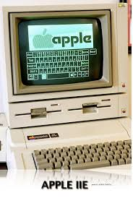
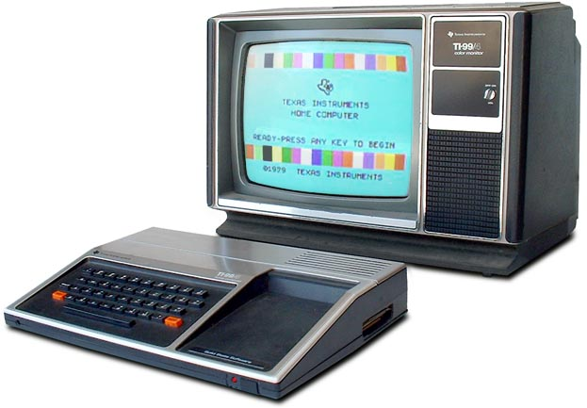
Your Professor
Wrote first program on a TI99/4a hooked up to the family’s TV-set in 1981 ish. Moved on to an Apple][e in HS

Slide 4
Your Professor
BS in Computing Sciences w/ Math and Chemistry minors from University of Scranton
MS in Computing Sciences from Drexel University
Professional Software Engineering experience in Aerospace, Finance, Marketing, Banking
10 years teaching at Drexel
Started at Ursinus in 2011

Slide 5
The Business of the Class
Syllabus
Schedule
Academic Honesty

